Slide 1
Decision Trees

Slide 2
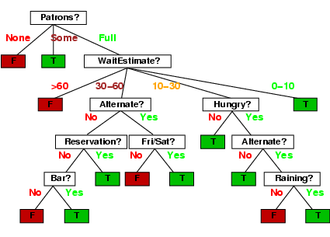
Decision trees
One possible representation for hypotheses
E.g., here is a tree for deciding whether to wait:

Slide 3
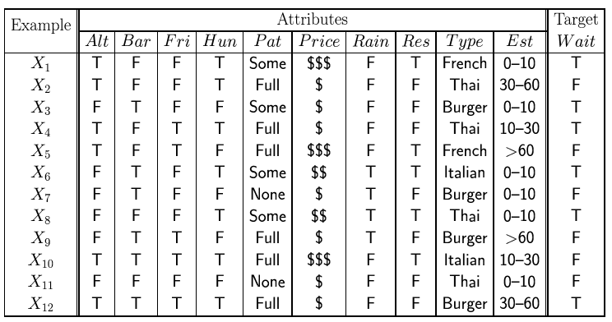
Attribute-based representations
Examples described by attribute values (Boolean, discrete, continuous)
E.g., situations where I will/won't wait for a table:
Classification of examples is positive (T) or negative (F)
12 examples
6 +
6 -

